Slide 1


Vehicle Headway Management on Rhode Island Highways
Máximo Polanco
Miao Song
John Brito
Dr. J.H. Wang

Slide 2
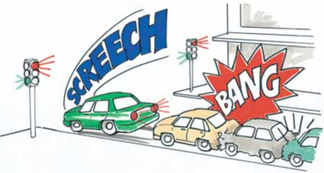
Agenda
Tailgating
Vehicle Headway
Preliminary Study
Video Analysis on Vehicle Headway
Survey
Results

Slide 3
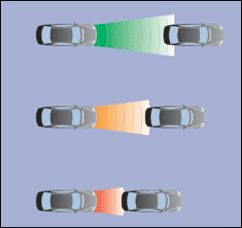
Tailgating
Tailgating is the dangerous practice of following very close to the vehicle in front.
In most circumstances a proper gap is 2 seconds long.
Close following or the advanced driver's "overtaking position" are about 1 second behind the vehicle in front.

Slide 4
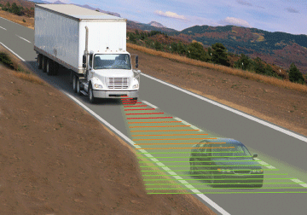
Tailgating
Anything closer than about 1 second can reasonably be described as tailgating, although some people only use the term when the following distance is very small, perhaps under one car's length.

Slide 5
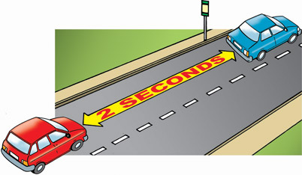
Vehicle Headway
Although standards and practices vary from state to state and from individual to individual, a minimum 2 second vehicle headway has been viewed as a rule of the road.

Slide 6
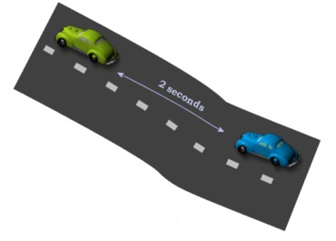
Vehicle Headway
From the preliminary study most drivers surveyed considered a following distance between 1 and 10 car lengths safe.
The 2 second rule demands at least 11 car lengths, while driving in a 60 mph Highway.

Slide 7
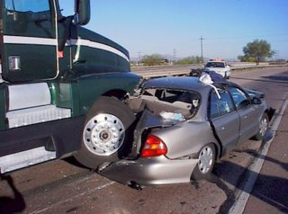
Crashes in RI
6.5 million accidents per year.
  2.5 involved reduced vehicle headways (Rear end Crashes).
12,ooo Fatalities in Vehicle Accidents in the US.
In Rhode Island, speeding accounts for 52% of all statewide fatalities. 32% is the National Avg.
Major Causes.
  Most RI drivers are driving with an insufficient headway.

Slide 8
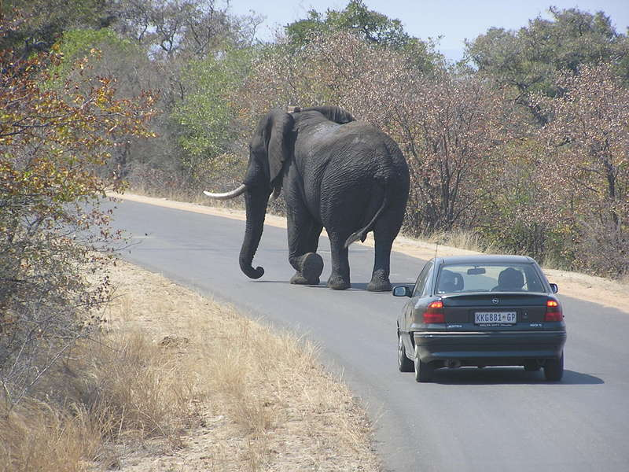
A Study on the Cause of and Treatment for Tailgating
Stages
  Literature Review.
  Identify causes of tailgating.
  Identify tailgating treatments.

Slide 9
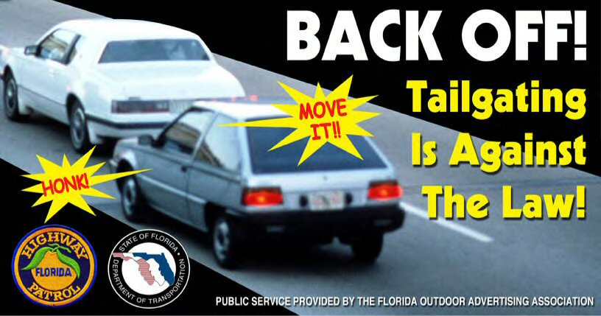
Vehicle Headway Management Study
Purpose
  Examine Vehicle Headway issue.
  Seek an effective Vehicle Headway management system for RI.
    Survey (Studying the Vehicle Headway Treatments).

Slide 10
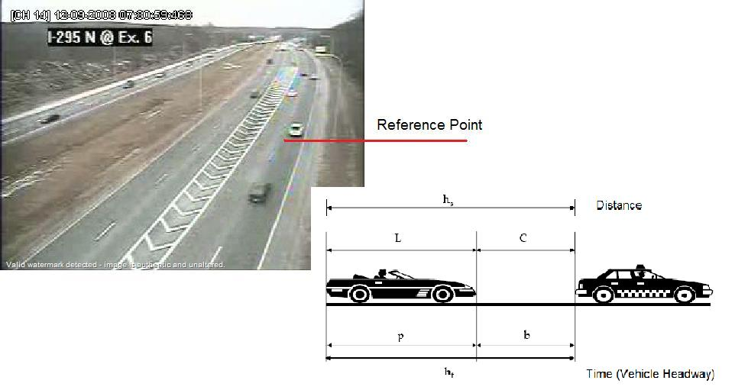
Vehicle Headway Analysis
Data Collection

Slide 11

Vehicle Headway Analysis
Identify
  1 second Tailgaters
  2 second Tailgaters
  3 second Tailgaters
  Non-Tailgaters
  Variation of Rush Hour and Non-Rush Hour
  Variation by Lanes

Slide 12
Vehicle Headway Analysis
Higway Section |  | I-295 N @ Ex. 6
Day |  | Rush Hour | Non-Rush Hour
12/09/2008 | 1-sec | 32.35% | 14.98%
 | 2-sec | 56.61% | 28.10%
 | 3-sec | 66.51% | 37.70%
12/10/2008 | 1-sec | 28.53% | 11.83%
 | 2-sec | 56.48% | 29.58%
 | 3-sec | 68.40% | 40.27%
12/11/2008 | 1-sec | 21.57% | 7.20%
 | 2-sec | 49.56% | 21.61%
 | 3-sec | 62.68% | 34.32%

Slide 13
Vehicle Headway Analysis with Lane Break-downs
Higway Section |  | I-295 N @ Ex. 6
Lanes (from left) |  | 1st Lane |  | 2ndst Lane |  | 3rd Lane |  | 4th Lane
Day |  | Rush Hour | Non-RH | Rush Hour | Non-RH | Rush Hour | Non-RH | Rush Hour | Non-RH
12/09/2008 | 1-sec | 49.17% | 21.43% | 10.47% | 13.33% | 10.75% | 2.63% | 25.61% | 16.22%
 | 2-sec | 76.35% | 38.10% | 25.13% | 16.67% | 23.66% | 21.05% | 55.09% | 37.84%
 | 3-sec | 85.48% | 38.10% | 37.70% | 23.33% | 26.88% | 31.58% | 66.67% | 45.95%
12/10/2008 | 1-sec | 40.20% | 25.57% | 7.56% | 5.44% | 7.06% | 0.00% | 26.33% | 6.52%
 | 2-sec | 73.20% | 42.05% | 23.26% | 23.13% | 16.47% | 6.35% | 56.00% | 31.16%
 | 3-sec | 86.20% | 51.14% | 35.47% | 33.33% | 25.88% | 9.52% | 66.00% | 47.83%
12/11/2008 | 1-sec | 28.38% | 13.71% | 8.06% | 1.43% | 15.15% | 5.48% | 22.00% | 9.63%
 | 2-sec | 68.92% | 26.61% | 20.97% | 15.00% | 21.21% | 15.07% | 48.00% | 27.41%
 | 3-sec | 79.73% | 37.90% | 35.48% | 30.71% | 33.33% | 23.29% | 64.00% | 40.74%

Slide 14
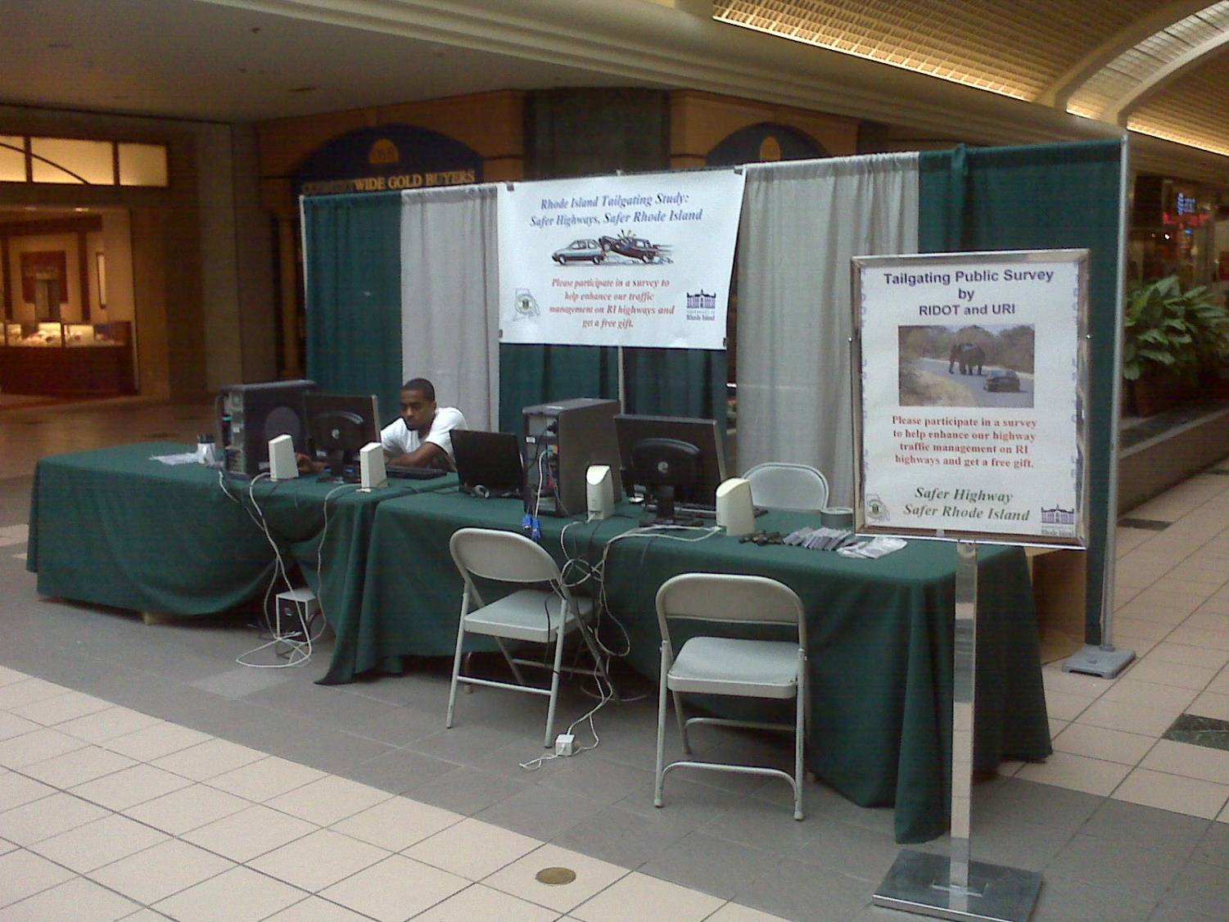
Survey (Studying the Vehicle Headway Treatments).
W
A
R
W
I
C
k
M
A
L
l

Slide 15
    Survey (Studying the Vehicle Headway Treatments).
Main Purposes
  Educate RI drivers about proper vehicle headway.
  Determine which Treatment is the most preferred .
Basic Questions
  Treatment
  Signs
  Graphics
  Traffic signs

Slide 16
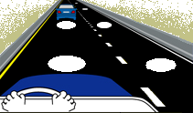
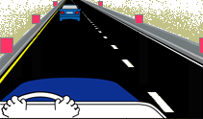


1.Which of the following would be most effective in helping you maintain a proper following distance?
Painted dots
Neon panels
Painted arrows
Bars

Slide 17
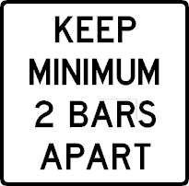
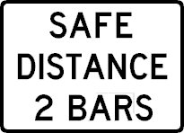
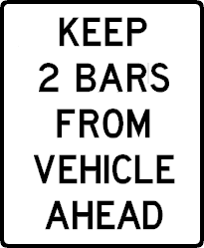
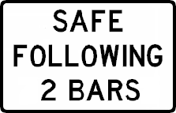
2. Which of the following signs would be easiest to understand?
Notes:
17

Slide 18
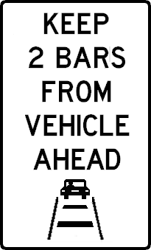
3. Which of the following signs would be easiest to understand?
Notes:
18

Slide 19




4. Which of the following signs would be easiest to understand?
Notes:
19

Slide 20

5. Which of the following signs would be easiest to understand?
Notes:
20

Slide 21
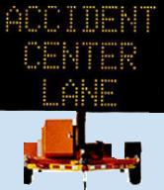


6. Which of the following traffic signs are you most likely to pay attention to while driving?
Static road signs
Overhead dynamic message signs
Roadside variable message signs
Notes:
21

Slide 22
Survey Results
Painted dots 9.15%
Neon panels 20.42%
Painted arrows 33.10%
Painted Bars 37.32%
Notes:
There will be Four videos containing each of the following tailgating treatments will be displayed next and please choose the one you preferred. They are painted dots, painted arrows, neon panels, and painted bars.

Slide 23
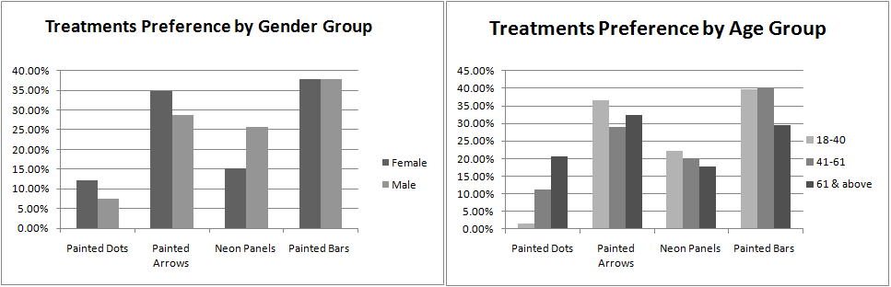
Analysis by Gender and Ag Groups

Slide 24
Survey Results
Preferred messages and signs.
45.07% Preferred this message. 81.69% Preferred it with Graphics.
40.14% Preferred this message.
86.62% Preferred it with Graphics.
46.48% Preferred dynamic overhead signs.

Slide 25
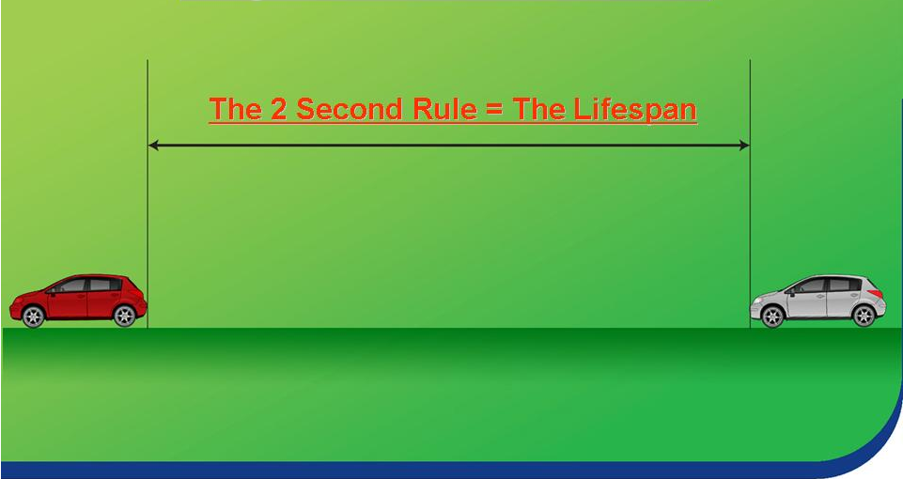
Vehicle Headway Management on Rhode Island Highways
Vehicle Headway
Questions?????
Safe Distance 2 BARS!!!
bar
bar

